Slide 1
Canteen Website
deepansh srivastav (2002901520045 / cs(ai) / a)
manas ghughtyal (2002901550015 / iot )

Slide 2
Objective
The objective of this presentation is to introduce and showcase the project website for our college canteen.
We aim to inform and engage our target audience, including students, staff, and faculty, about the features and benefits of the website, while emphasizing its role in enhancing their overall dining experience.

Slide 3
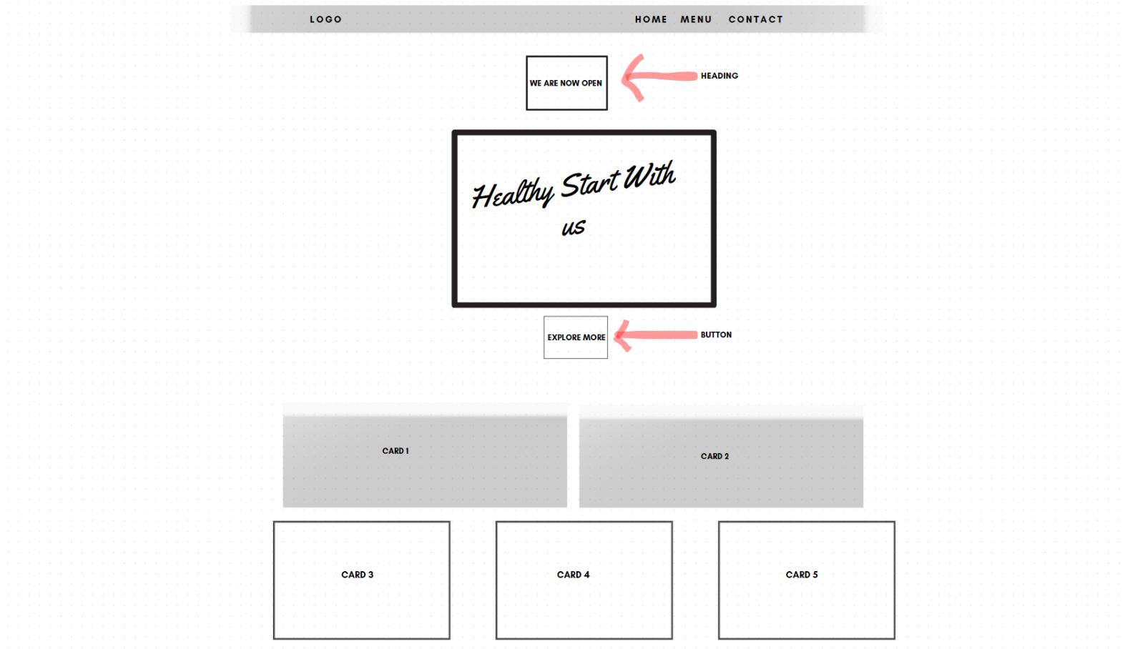
Layout
Home page / Landing page

Slide 4
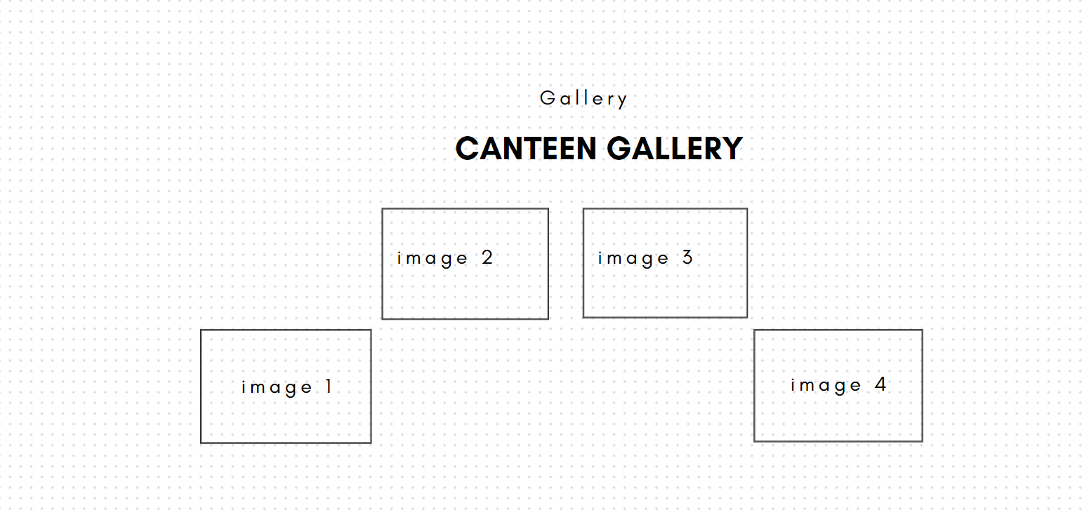
Layout
Canteen Gallery on Home page

Slide 5
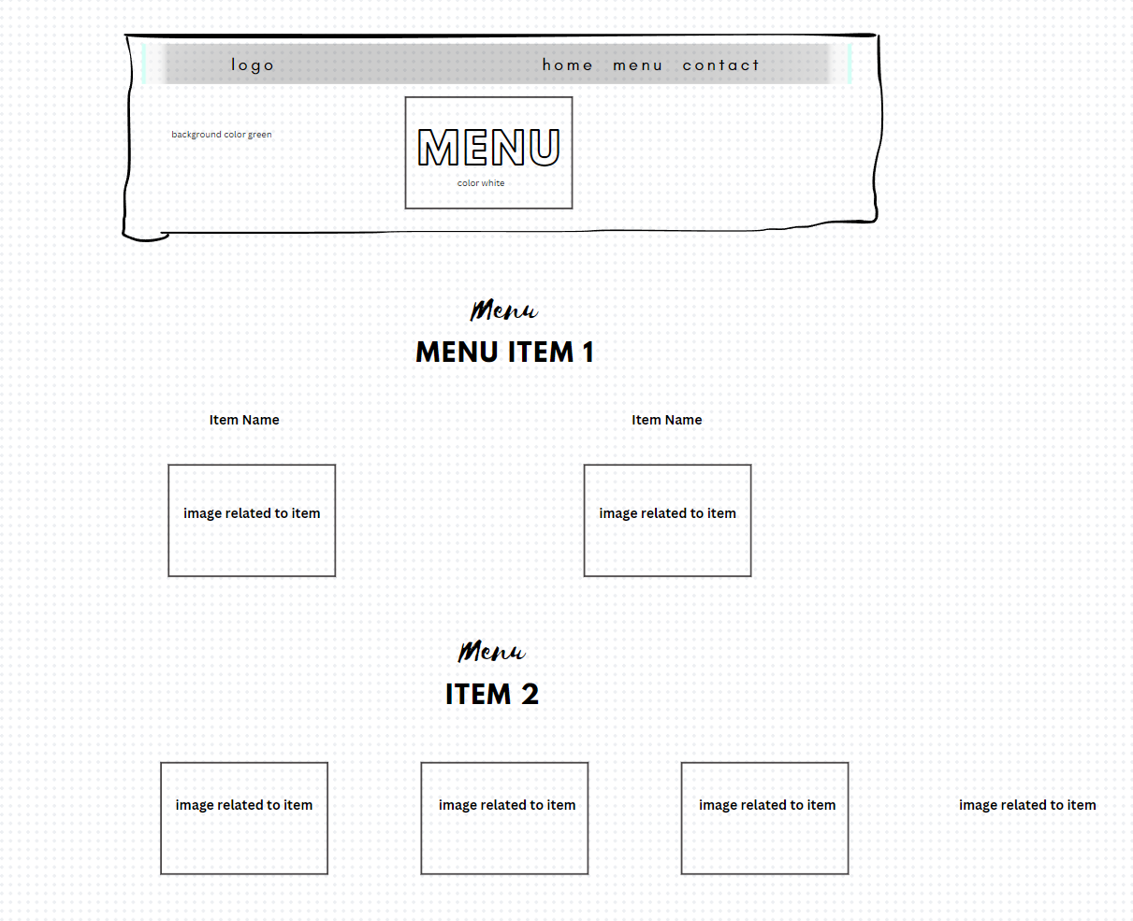
Layout
Menu Page

Slide 6
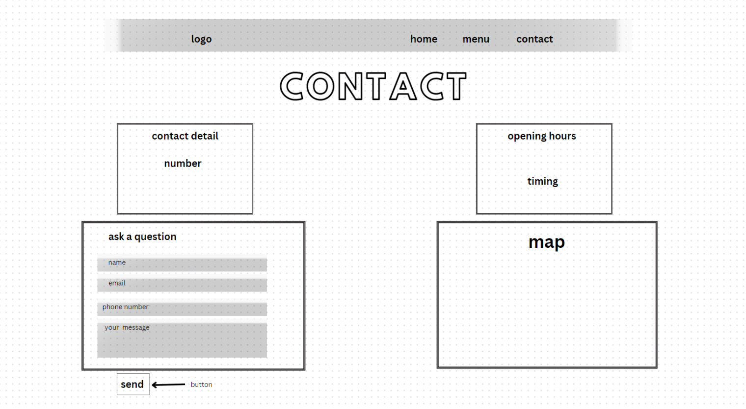
Layout
Contacts Page

Slide 7
Details about component
Accordion-
An accordion on a web page is a user interface (UI) component that allows users to expand and collapse sections of content within a vertical stack.
Navbar-
A navbar (short for navigation bar) is a common component used to provide a navigation menu for a website.
Cards-
A card refers to a container element that is used to organize and present information in a structured and visually appealing manner.
Dropdowns-
A dropdown is a user interface element that presents a list of options for the user to choose from in a menu-like fashion.

Slide 8
Details about component
Accordion-
A form is an essential element that allows users to interact with a webpage by entering and submitting data.
Button-
A button is an interactive element that users can click or tap to trigger a specific action or event.
Carousel
A carousel is a component commonly used in web design to display a series of images or content in a slideshow format.

Slide 9


